Slide 1
A Distributed Card Game with a Replicated File System
Brandon Dotson

Slide 2
Outline
Introduction
Background
Approach
Results
Significance
Challenges & Improvements

Slide 3
Introduction
The main goals of this project were the following:
Implement a distributed card game
Include an underlying replicated file system

Slide 4
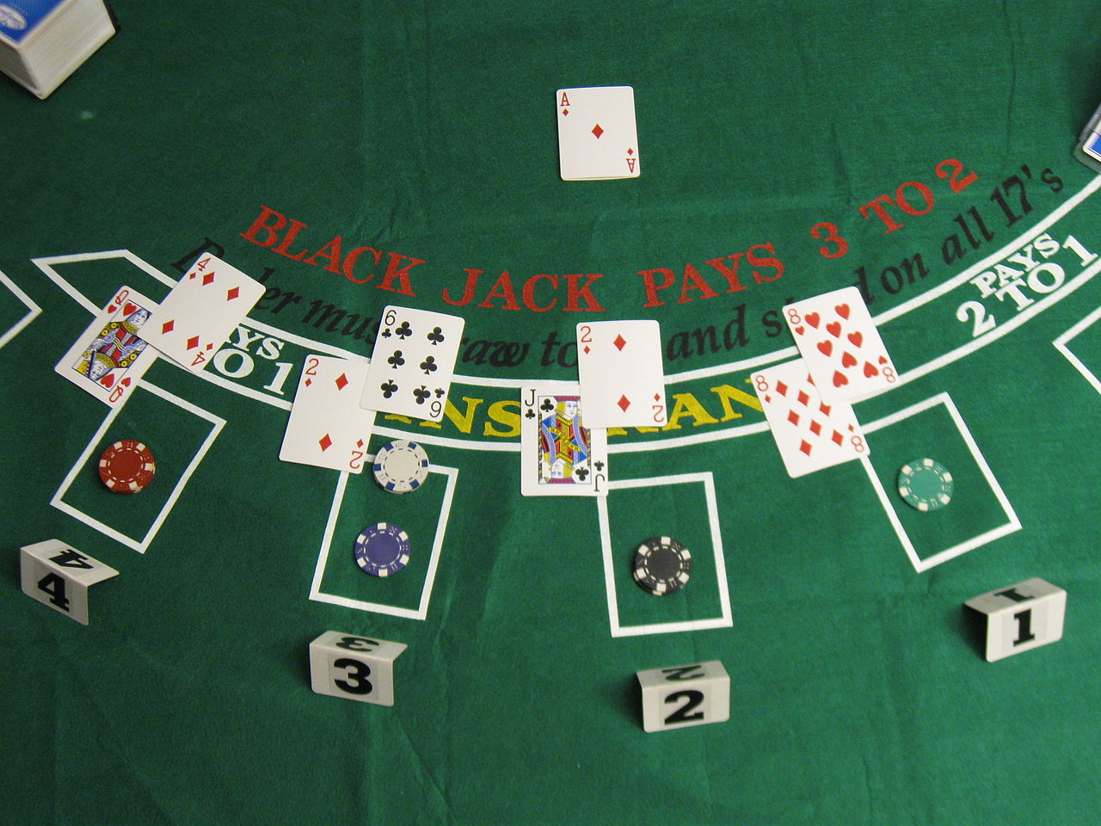
Background - Blackjack
Draw cards without going above 21 points
Must have a higher score than dealer
Number cards worth their numerical value
Face cards worth 10 points
Aces are worth 1 or 11 point(s), depending

Slide 5
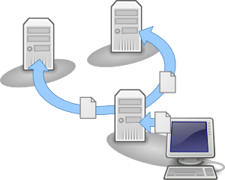
Background - Replicated File System
Distributed File System
Additional servers used to hold file copies
Adds redundancy in case of failure
Could help with file security

Slide 6
Approach - Overview
Used remote procedure calls for distributed environment
Included server and varying quantity of backup servers and clients
Used centralized server with 4 threads to handle rpc work
Server handled most of game management and interactions

Slide 7
Approach - Game Flow
Server creates a vector that acts as deck and shuffles it
Server waits for 4 clients that will act as players
Server removes “cards” from vector and allocates them to players
Server stores game information in log and passes it to backup servers
Each player downloads log from server and decides their move
Server acts and compares players’ hands to its own and declares winners

Slide 8
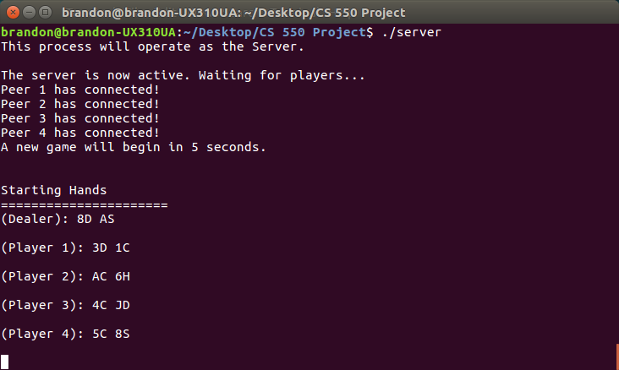
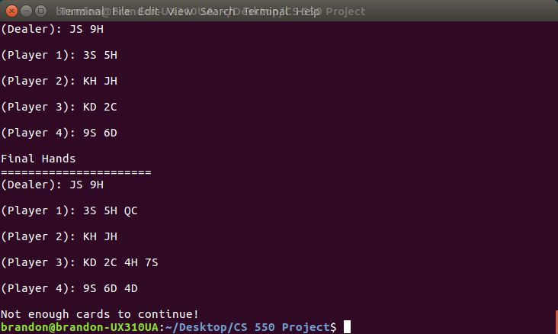
Results - Server

Slide 9
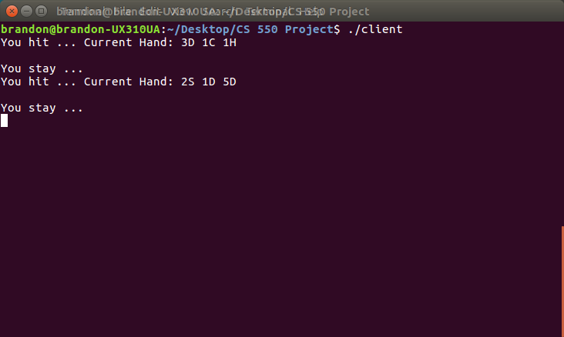
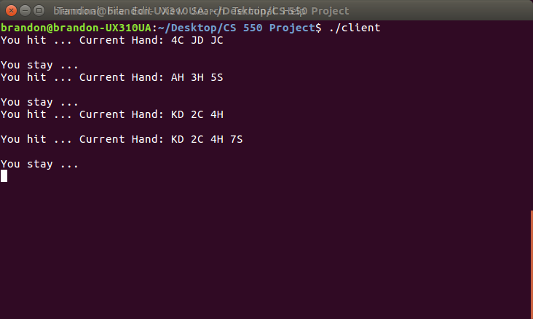
Results - Client

Slide 10
Significance
World beginning to rely more on distributed systems
As technology improves, the exploits do too
Security and reliability measures must keep pace
Some added fun while tackling a problem

Slide 11
Challenges & Improvements
Challenges
Difficulties with rpclib library
Reliance on global variables
Synchronization trouble
Issues implementing graphics
Improvements
Allowing clients to leave/join seamlessly
Varying client behavior and deck order
Add endless decks
Add graphically representation
More clarity with text output

Slide 12
Sources
RPClib, http://rpclib.net
SDL, https://www.libsdl.org/
Wikipedia, https://en.wikipedia.org/wiki/Blackjack

Slide 13
Questions?

